Slide 1




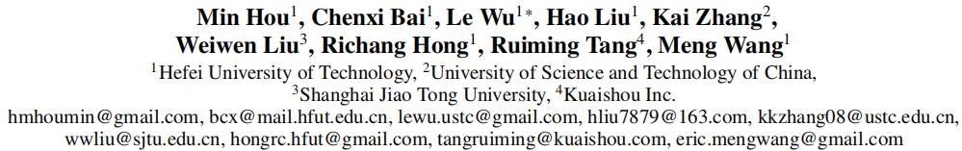





ATAI
Advanced Technique of Artificial Intelligence
ATAI
ChongqingUniversity _{AdvancedTechniqueof}
of Technology Artificial Intelligence
Chongqing University of
Technology
Chongqing University ^{ATAI}
_{of Technology} Advanced Techniqueof
Artificial Intelligence
Chongqing University of Technology
Chongqing University of Technology
RecCocktail: A Generalizable and Efficient Framework for
LLM-Based Recommendation
Code:https://anonymous.4open.science/r/RecCocktail
—— AAAI_2026
Reported by Long Zhang
1

Slide 2
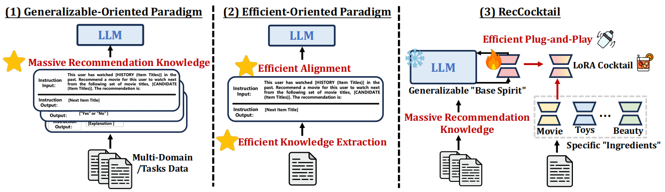
ATAI
Advanced Technique of Artificial Intelligence
ATAI
ChongqingUniversity _{AdvancedTechniqueof}
of Technology Artificial Intelligence
Chongqing University of
Technology
Chongqing University ^{ATAI}
_{of Technology} Advanced Techniqueof
Artificial Intelligence
Chongqing University of Technology
Chongqing University of Technology
Motivation
1) The first paradigm designs multi-domain or multi-task instruction data for generalizable recommendation, so as to align LLMs with general recommendation areas and deal with cold-start recommendation.
2) The second paradigm focuses on enhancing domain-specific recommendation tasks, improving performance in warm recommendation scenarios.
While most previous works treat these two paradigms separately, we argue that they have complementary advantages, and combining them can yield better results.

Slide 3
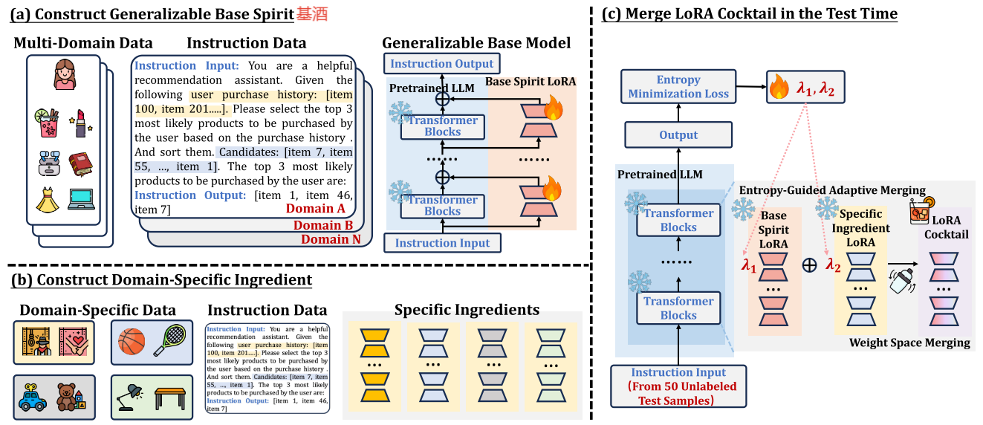
ATAI
Advanced Technique of Artificial Intelligence
ATAI
ChongqingUniversity _{AdvancedTechniqueof}
of Technology Artificial Intelligence
Chongqing University of
Technology
Chongqing University ^{ATAI}
_{of Technology} Advanced Techniqueof
Artificial Intelligence
Chongqing University of Technology
Chongqing University of Technology
Method

Slide 4
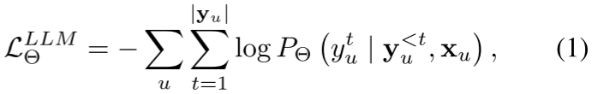
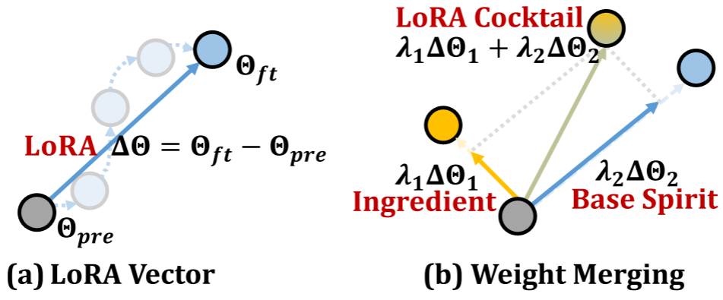
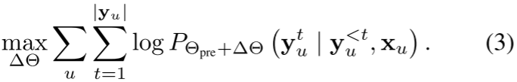


ATAI
Advanced Technique of Artificial Intelligence
ATAI
ChongqingUniversity _{AdvancedTechniqueof}
of Technology Artificial Intelligence
Chongqing University of
Technology
Chongqing University ^{ATAI}
_{of Technology} Advanced Techniqueof
Artificial Intelligence
Chongqing University of Technology
Chongqing University of Technology
Method

Slide 5
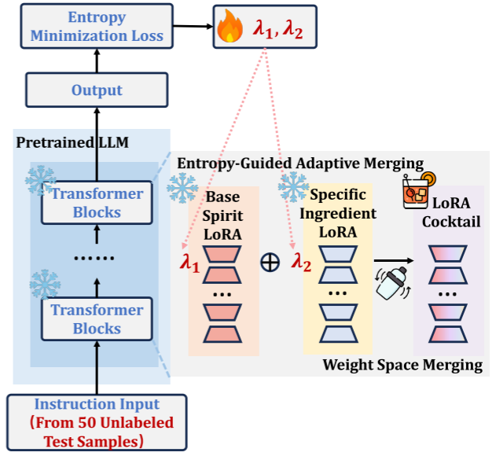

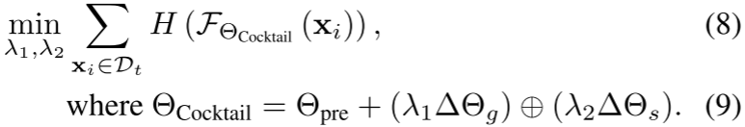
ATAI
Advanced Technique of Artificial Intelligence
ATAI
ChongqingUniversity _{AdvancedTechniqueof}
of Technology Artificial Intelligence
Chongqing University of
Technology
Chongqing University ^{ATAI}
_{of Technology} Advanced Techniqueof
Artificial Intelligence
Chongqing University of Technology
Chongqing University of Technology
Method

Slide 6
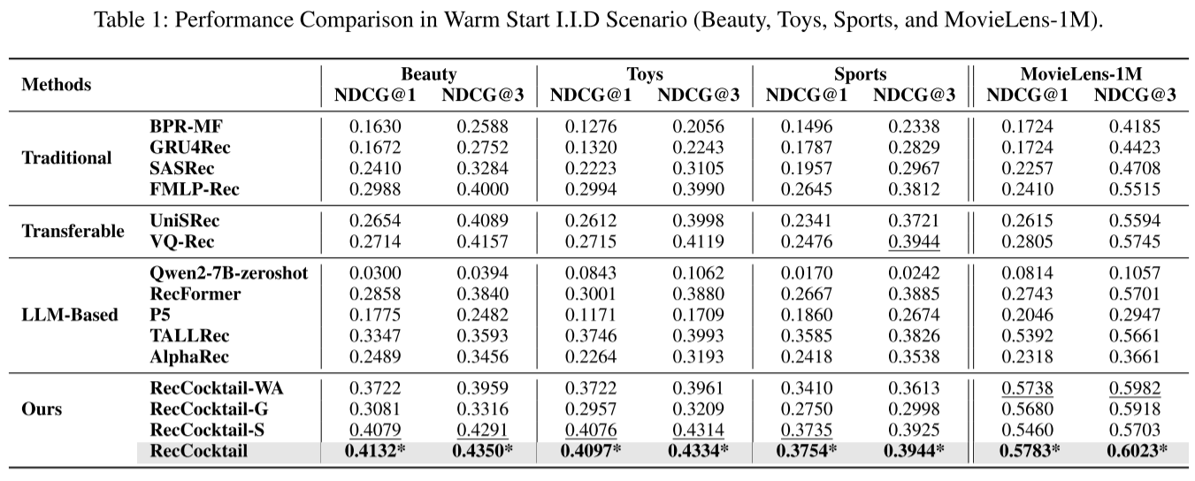
ATAI
Advanced Technique of Artificial Intelligence
ATAI
ChongqingUniversity _{AdvancedTechniqueof}
of Technology Artificial Intelligence
Chongqing University of
Technology
Chongqing University ^{ATAI}
_{of Technology} Advanced Techniqueof
Artificial Intelligence
Chongqing University of Technology
Chongqing University of Technology
Experiments

Slide 7
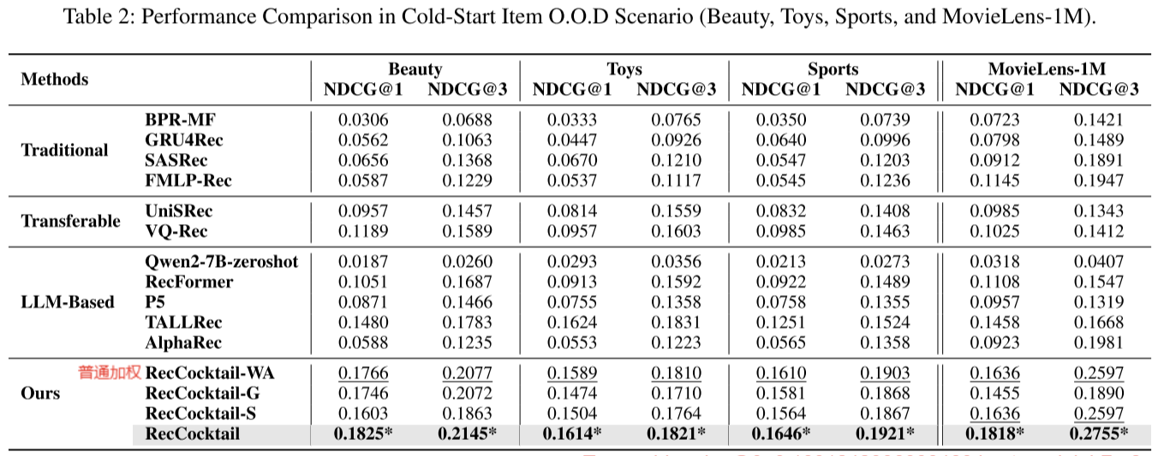
ATAI
Advanced Technique of Artificial Intelligence
ATAI
ChongqingUniversity _{AdvancedTechniqueof}
of Technology Artificial Intelligence
Chongqing University of
Technology
Chongqing University ^{ATAI}
_{of Technology} Advanced Techniqueof
Artificial Intelligence
Chongqing University of Technology
Chongqing University of Technology
Experiments

Slide 8
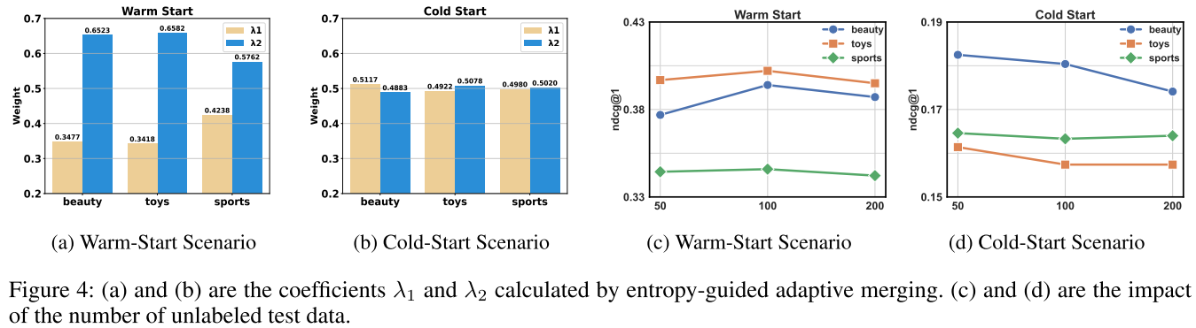
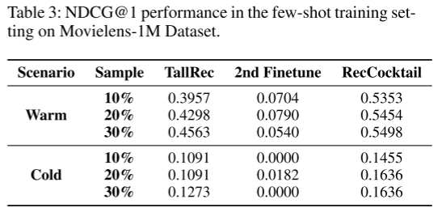
ATAI
Advanced Technique of Artificial Intelligence
ATAI
ChongqingUniversity _{AdvancedTechniqueof}
of Technology Artificial Intelligence
Chongqing University of
Technology
Chongqing University ^{ATAI}
_{of Technology} Advanced Techniqueof
Artificial Intelligence
Chongqing University of Technology
Chongqing University of Technology
Experiments

Slide 9


ATAI
Advanced Technique of Artificial Intelligence
ATAI
ChongqingUniversity _{AdvancedTechniqueof}
of Technology Artificial Intelligence
Chongqing University of
Technology
Chongqing University ^{ATAI}
_{of Technology} Advanced Techniqueof
Artificial Intelligence
Chongqing University of Technology
Chongqing University of Technology
Thanks!

